Slide 1
Projectiles
Equation of trajectory
Lesson 4

Slide 2
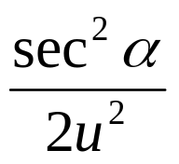
Equation of trajectory
y = x tan α - gx²

Slide 3
Example 1
A basketball player throws the ball into the net, which is 3m horizontally from and 1m above the player’s hands. The ball is thrown at 50⁰ to the horizontal. How fast is it thrown?

Slide 4
Example 2
A boy is standing on the beach and his sister is at the top of a cliff 6m away at a height of 3m. He throws her an apple with a speed of 10 ms⁻¹. In what direction should he throw it?

Slide 5
Example 3
An archer releases an arrow with a speed 70ms⁻¹ at an angle of 25⁰ to the horizontal. Calculate the range of the arrow. Determine the height of the arrow above its initial level when it has traveled a horizontal distance of 50m, and find the other horizontal distance for which it has the same height.

